Slide 1
T
T
o
y
o
y
a
P
i
a
P
i
e
d
e
d
POWERPOINT PRESENTATION
Toypedia Online Forum
Database System Design & Implementation

Slide 2
1
Original Interests
The purpose of instructing the original Toypedia
Part 01

Slide 3
The Original Interests
Basic Functions
Collection Fascination
User Management, Content Posing, Post Replying
People love to collect things
Information Sharing
An online forum for people to share information

Slide 4





Problems & Issues
Limited Storage Capacity
Budget Overrun
Posts are not reliable
Data Inconsistency

Slide 5
2
Major Data Questions
What the system can provide to users
Part 02

Slide 6
Which users have purchased products from the forum?
What products have been bought by the users?
What products are available in the forum and who are there respective vendors?
What is the top selling product of the forum?
What is the total revenue of each product?
Who are the users of the forum?
Possible Question

Slide 7
3
Part 03
Database ERD Display
This ERD is a composite of four different parts

Slide 8
External Entity
User
Employee
Courier
Vendor
Address
Access Type

Slide 9
Content Post & Reply
Post Category
Content Post
Post Reply
Status Type

Slide 10
Product Purchasing Functionality
Product Category
Product
Product Supply
Vendor
Purchase
Purchase Line

Slide 11
Payments & Shipping
Payment Method
Shipping Status
Delivery Status
Coupon

Slide 12
The Final Version

Slide 13
4
Demo Slides
For Two Groups: User Group & Administration Group
Notes:
本模板为微信公众号欢乐PPT原创模板 本模板在PPT插件：“PPT超市”内发布 请勿擅自传播，侵权必究

Slide 14





Functions for Different Group
For User Groups
For Administration Groups
User Log In
User Sign Up
Information Management
Posting & Replying
Purchase & Payment
User Information Management
User Purchase Order List
KPI
Package Shipping
Benefit Management

Slide 15
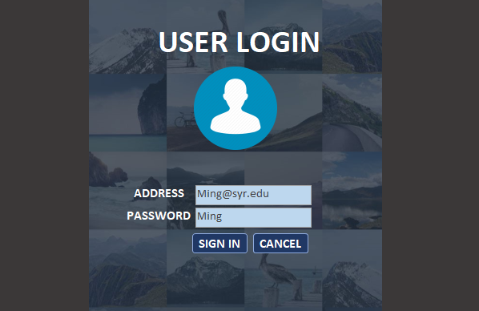

Slide 16
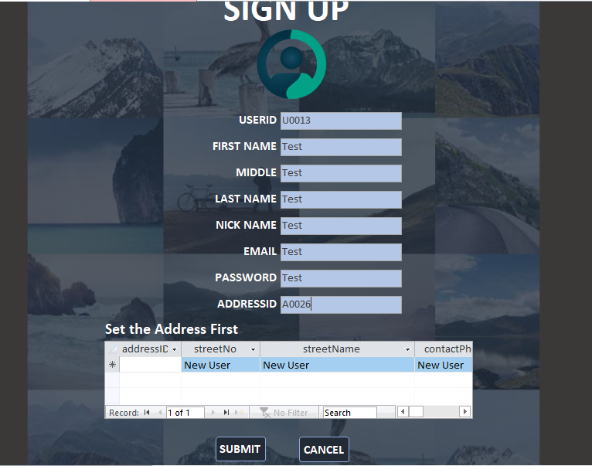

Slide 17
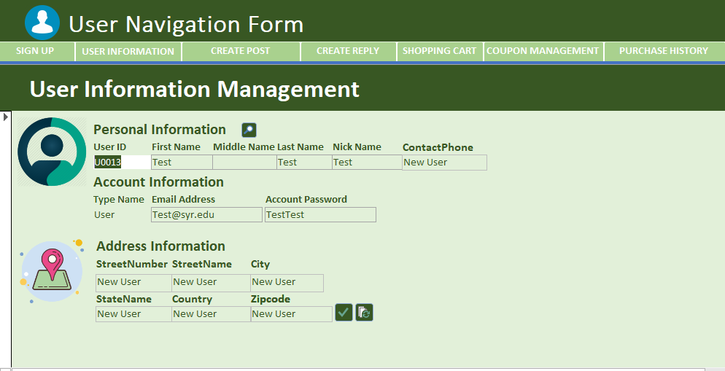

Slide 18
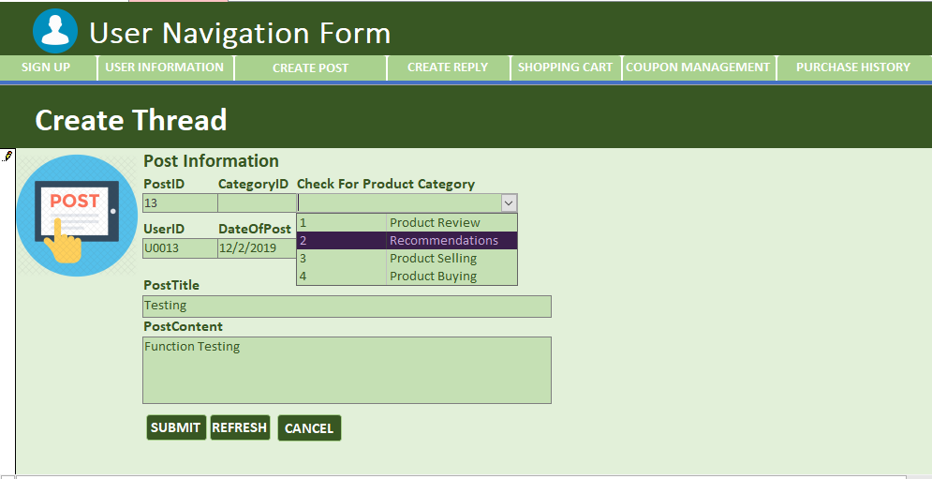

Slide 19
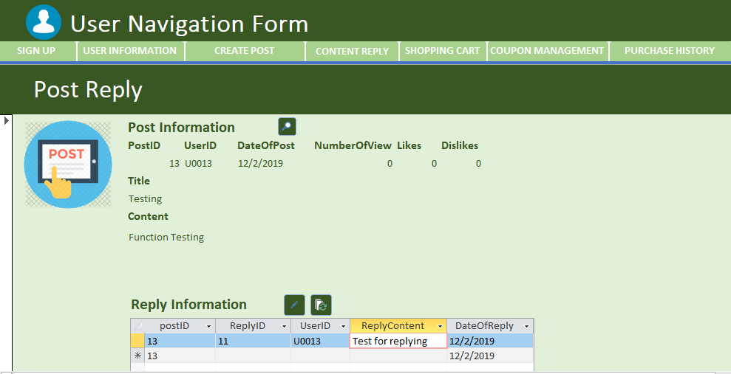

Slide 20
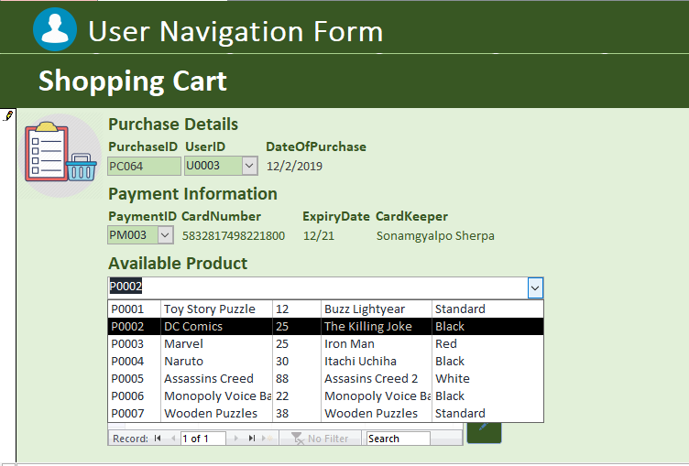

Slide 21
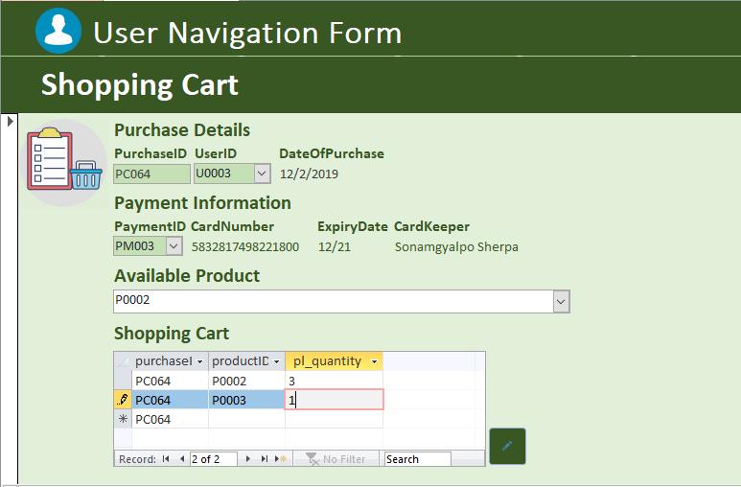

Slide 22
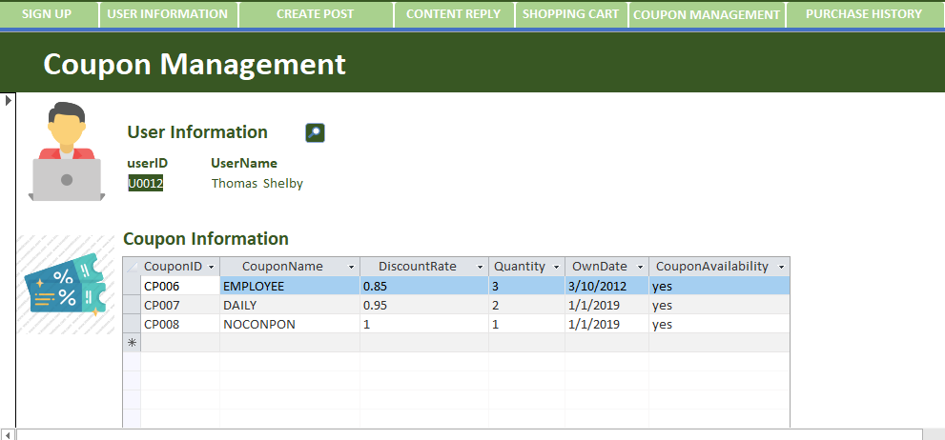

Slide 23
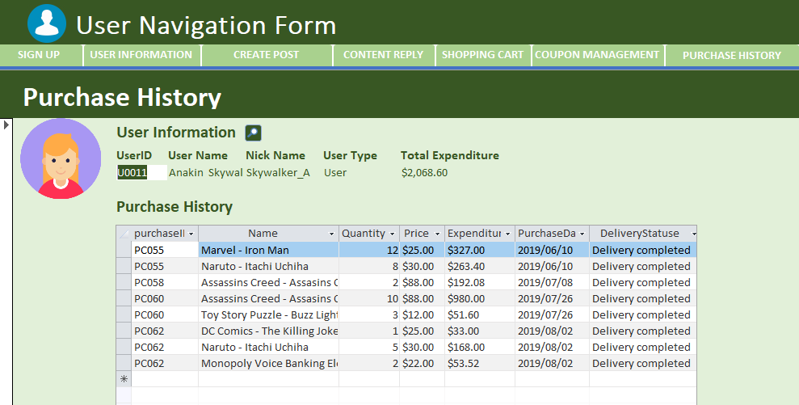

Slide 24
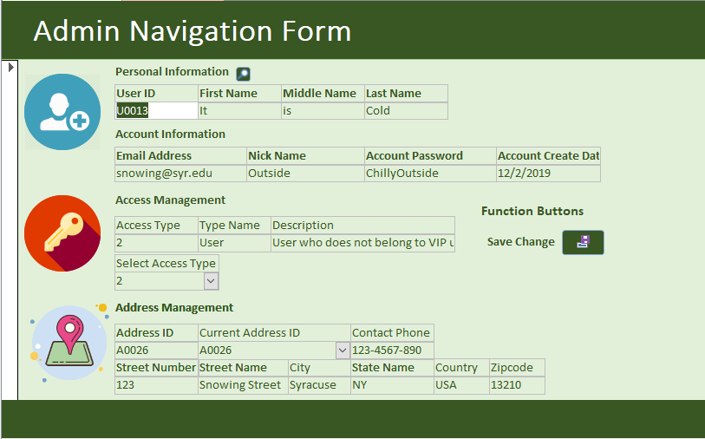

Slide 25
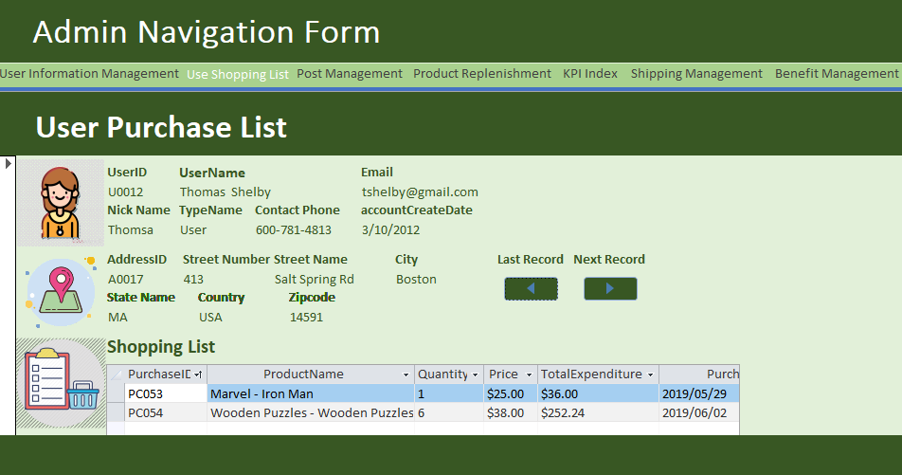

Slide 26
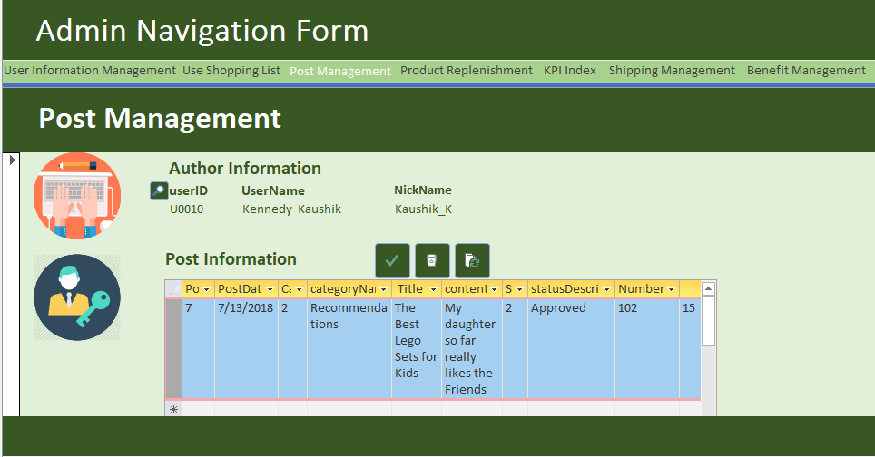

Slide 27
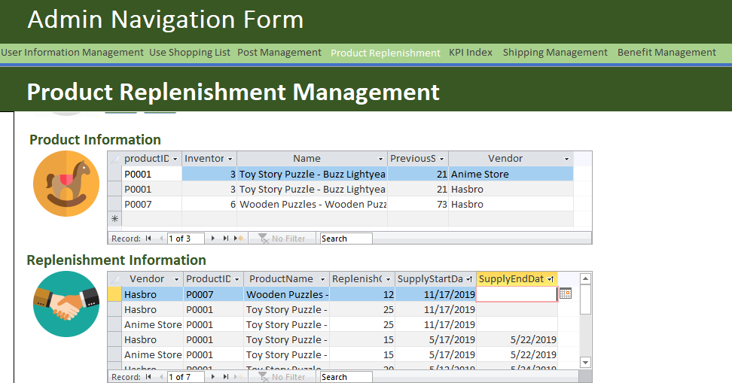

Slide 28
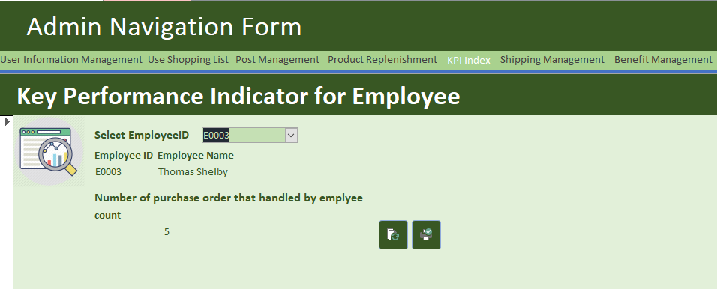

Slide 29
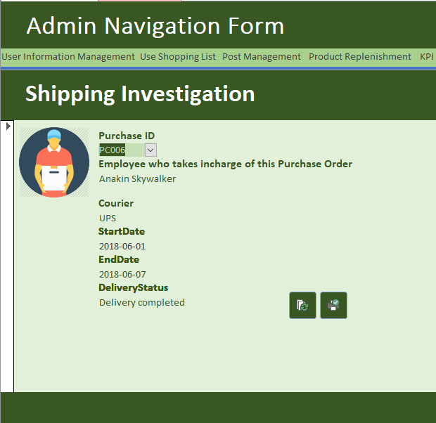

Slide 30
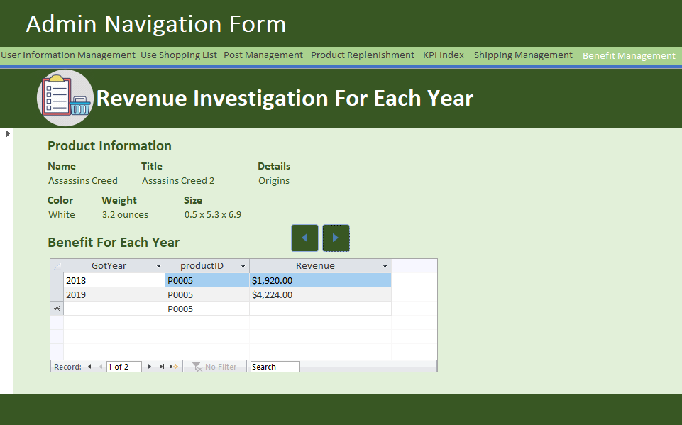

Slide 31
T
T
o
y
o
y
a
P
i
a
P
i
e
d
e
d
POWERPOINT PRESENTATION
Toypedia Online Forum
Database System Design & Implementation

